Slide 1
HELLO EVERYONE

Slide 2
GOOGLE TOOLS
Which makes the future in hands of an engineering

Slide 3
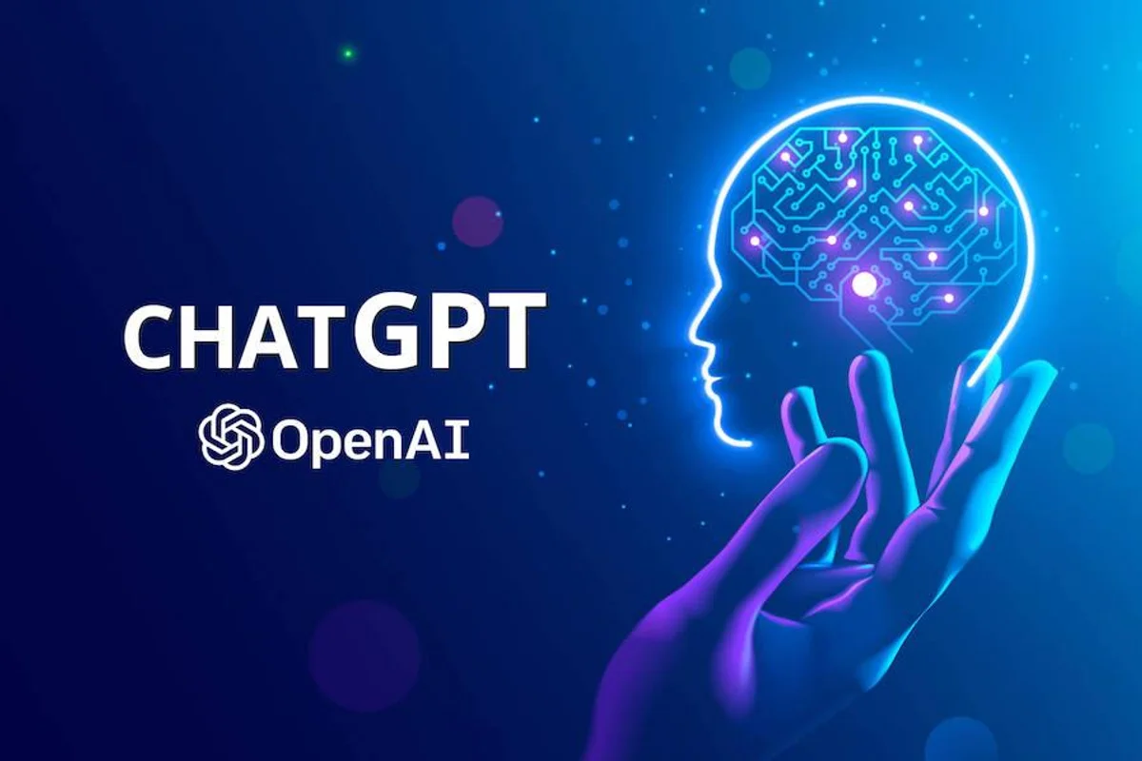
CHAT GPT

Slide 4
Origins and Market Value Snapshot
ChatGPT: Origins & Market ValueDeveloped by: OpenAI (founded 2015 by Elon Musk, Sam Altman, and others)Launch: ChatGPT released Nov 2022Technology: Based on GPT (Generative Pre-trained Transformer) modelsUsers: Over 100 million users in 2 months (fastest-growing app ever)
OpenAI Valuation & FundingValuation Growth:$29B (Jan 2023) → $157B (Oct 2024) → $300B+ (Mar 2025)Potential $500B valuation in 2025Major Investors: Microsoft (largest, 49% stake), SoftBank, NvidiaFunding: Over $60B raised so far
Key PointsOpenAI transformed from non-profit to AI leaderChatGPT’s rapid adoption highlights AI’s rising demandStrong backing by tech giants fuels growth

Slide 5
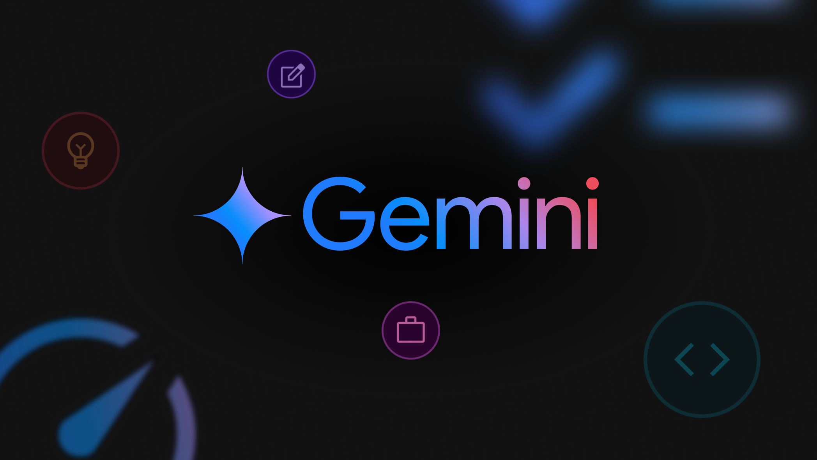
GEMINI

Slide 6
AI Innovation & Market Impact
Origins & Market ValueDeveloper: Google DeepMind (part of Alphabet)Launch: Gemini AI announced in 2023, with gradual rollout in 2024–2025Technology: Next-gen large language model combining advanced AI with Google’s vast data and capabilitiesGoal: Compete with OpenAI’s GPT models by integrating multi-modal AI (text, images, code)
Alphabet (Google’s Parent) Valuation & Investment: Alphabet Market Cap: Over $2.5 trillion (2025)Investment in AI: Billions poured into AI research and development via DeepMind and Google BrainStrategic Importance: Gemini is key to Google’s AI strategy, enhancing search, cloud, and productivity tools
Key Points : Gemini is Google’s answer to ChatGPT and advanced AI modelsDeepMind’s expertise strengthens Google’s AI edgeHuge backing from Alphabet’s resources fuels rapid AI innovation

Slide 7
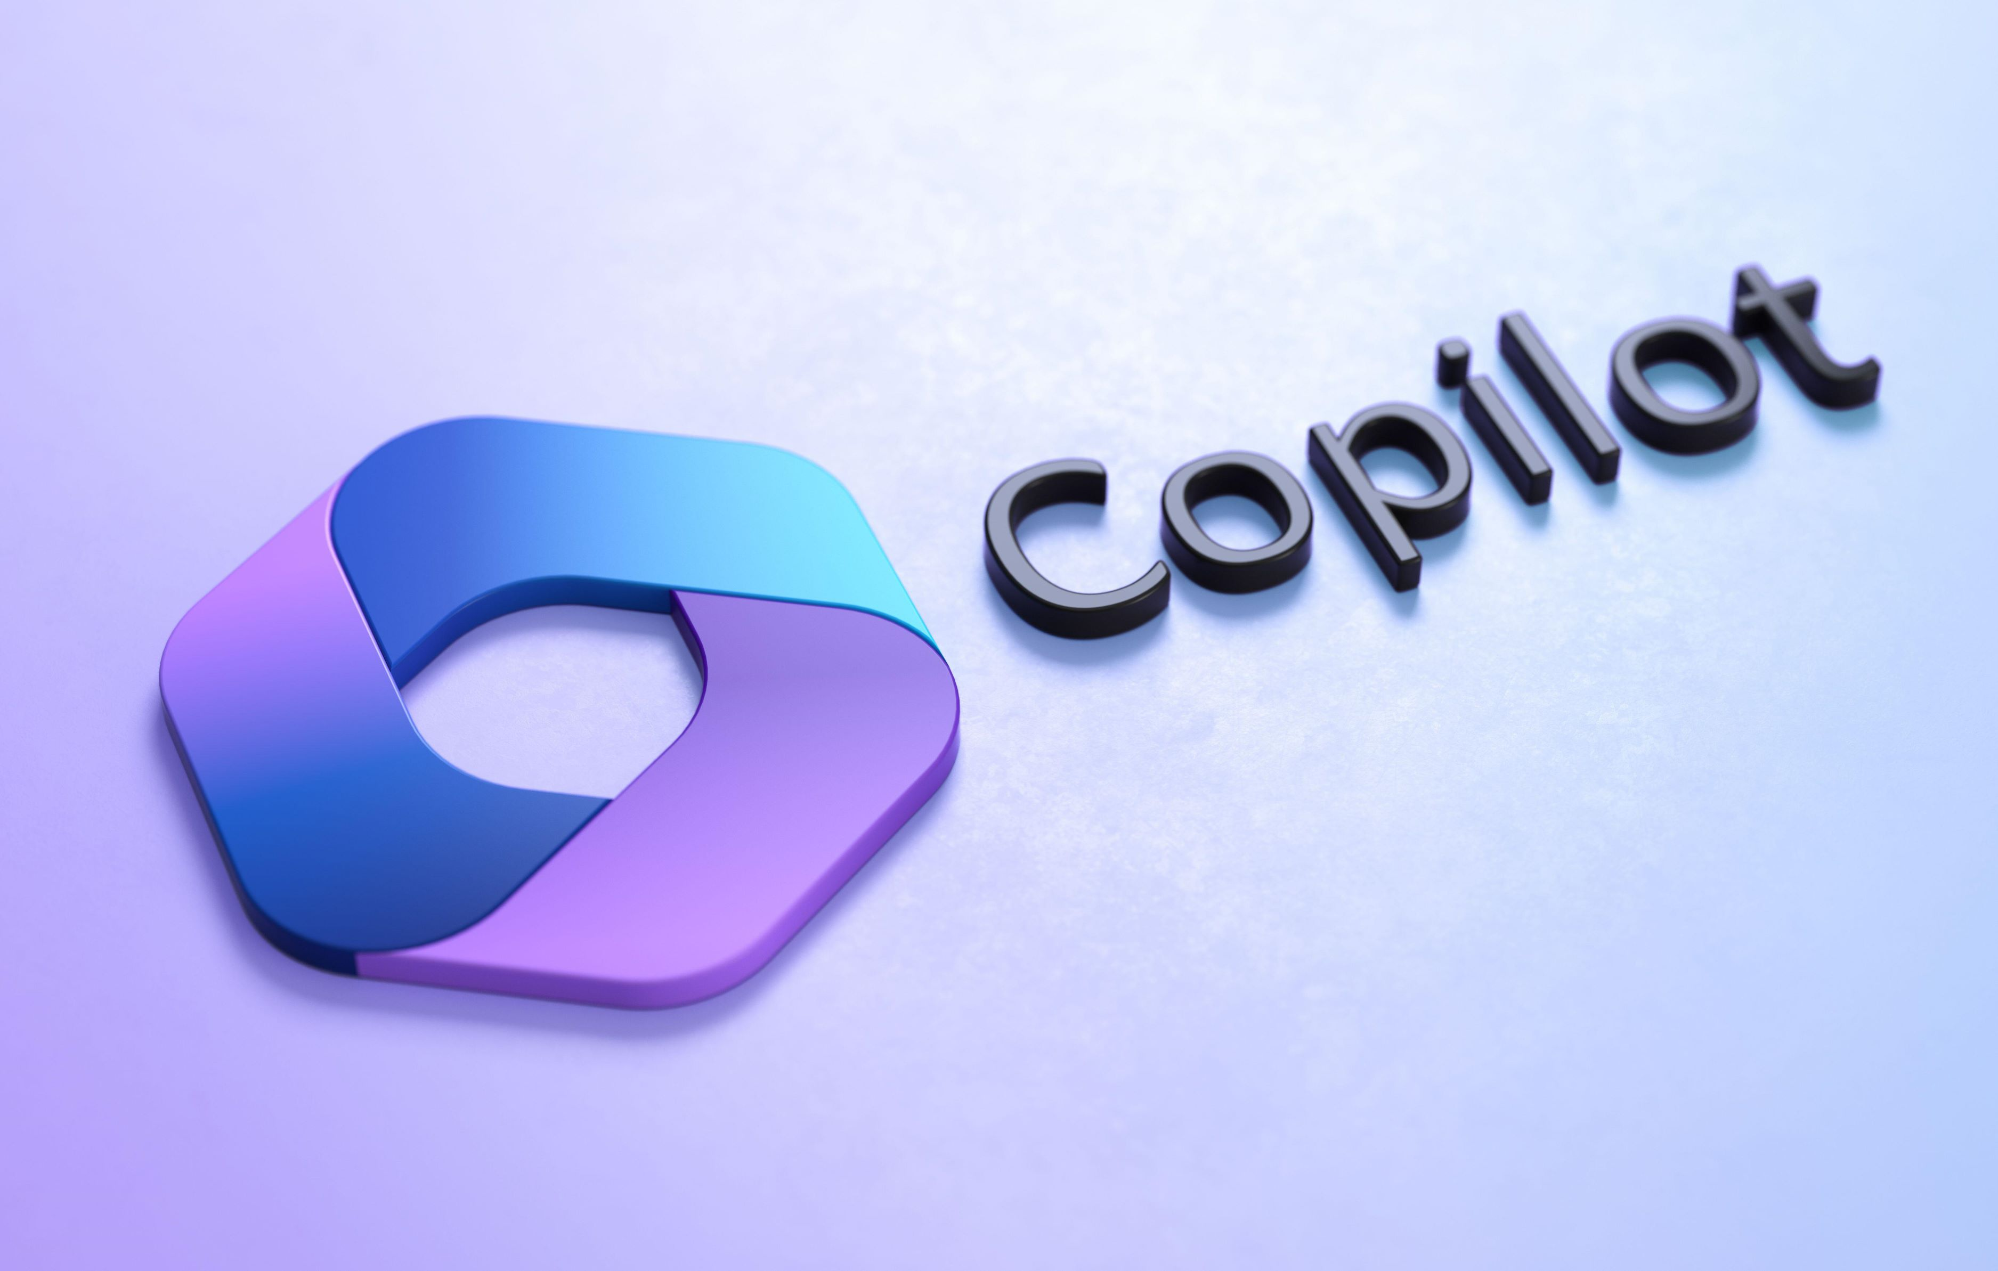
COPILOT

Slide 8
AI-Powered Coding Assistant
GitHub Copilot: Origins & Market ValueDeveloper: GitHub (owned by Microsoft)Launch: Publicly released in 2021Technology: AI-powered code assistant built on OpenAI’s Codex modelPurpose: Helps developers write code faster and with fewer errors by suggesting code snippets and completions
Microsoft & GitHub Valuation & InvestmentMicrosoft Market Cap: Around $2.8 trillion (2025)Investment: Microsoft heavily invested in AI, integrating Copilot across developer tools and productsImpact: Copilot is a flagship AI tool driving productivity in software development
Key Points Copilot revolutionizes coding with AI assistanceBuilt on OpenAI’s models, showcasing Microsoft-OpenAI partnershipSignificant role in Microsoft’s AI and developer strategy

Slide 9
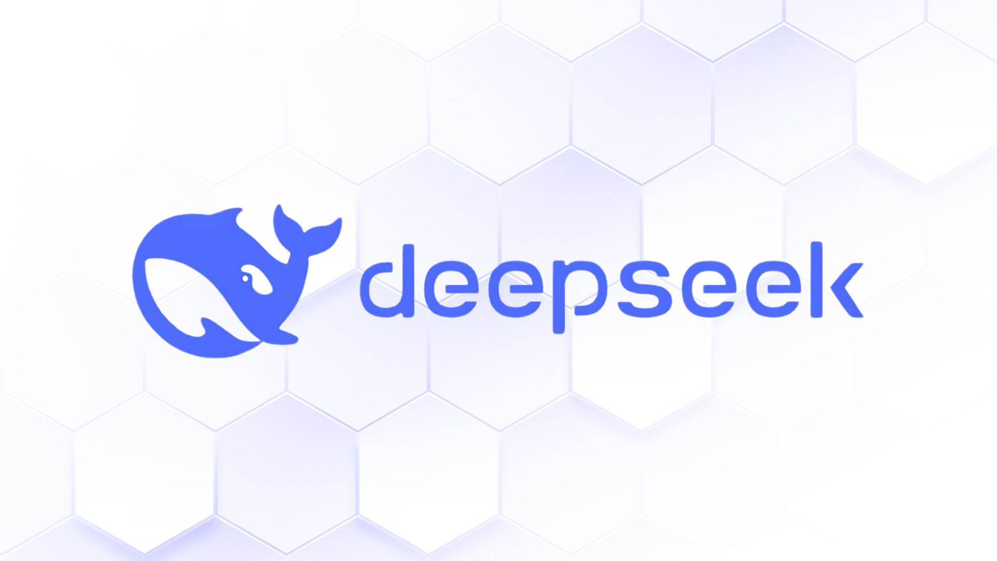
DEEP SEEK

Slide 10
Echoes of Midnight
Company Overview:DeepSeek AI founded in 2023 by Liang Wenfeng in ChinaBacked by hedge fund High-FlyerOperates privately; no stock ticker or market listing
Stock Market Status:No public shares available on ORIGIN or other exchanges NO IPO date announced or confirmed Not listed on pre-IPO platforms like Hiive or Linqto
Investment Possibilities : Accredited investors may access private shares if/when offered Currently no shares available for direct purchase
Market Impact: DeepSeek’s AI innovations influenced market valuations of AI leaders (e.g., Nvidia, Microsoft) Remains privately owned despite market
Key Takeaways :DeepSeek AI stock not available publicly yetWatch for IPO updates in the futureIndirect exposure through AI sector stocks recommended

Slide 11
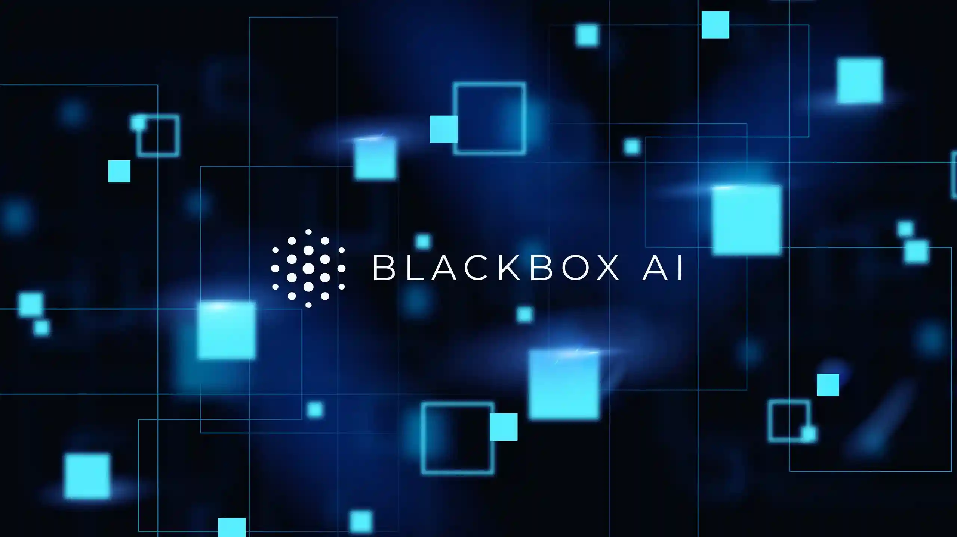
BLACK BOX

Slide 12
The Mysterious Minds of Machines
Black Box Limited (IT Company): This is a global IT solutions and services company
Origin: Founded in 1976 as "Expandor Inc.," the company was named after its early products, which were colloquially called "black boxes
Current Status: It is now a subsidiary of Black Box Limited, a company previously known as AGC Networks Limited, which acquired it in 2019.
Market Value: The company, Black Box Limited, has a market capitalization of approximately ₹7,645 crore on the Indian stock exchange as of mid-September 2025.

Slide 13

THANK YOU

